Slide 1
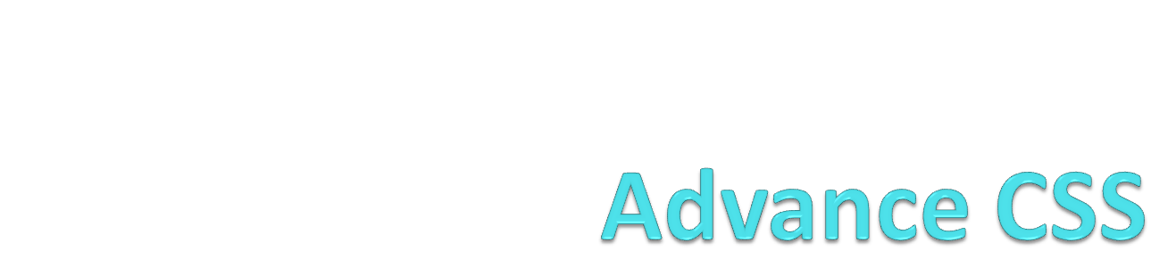

Slide 2
Box Model
What is the CSS Box Model: The CSS box model describes the boxes that are formed around elements of content in a Web page. Every element in a Web page is in a box or is a box, even if it's an image of a circle. The boxes on Web pages are constrained by rules defined by the box model.

Slide 3
Box Model
All HTML elements can be considered as boxes. In CSS, the term "box model" is used when talking about design and layout.
The CSS box model is essentially a box that wraps around every HTML element. It consists of: margins, borders, padding, and the actual content. The image below illustrates the box model:

Slide 4
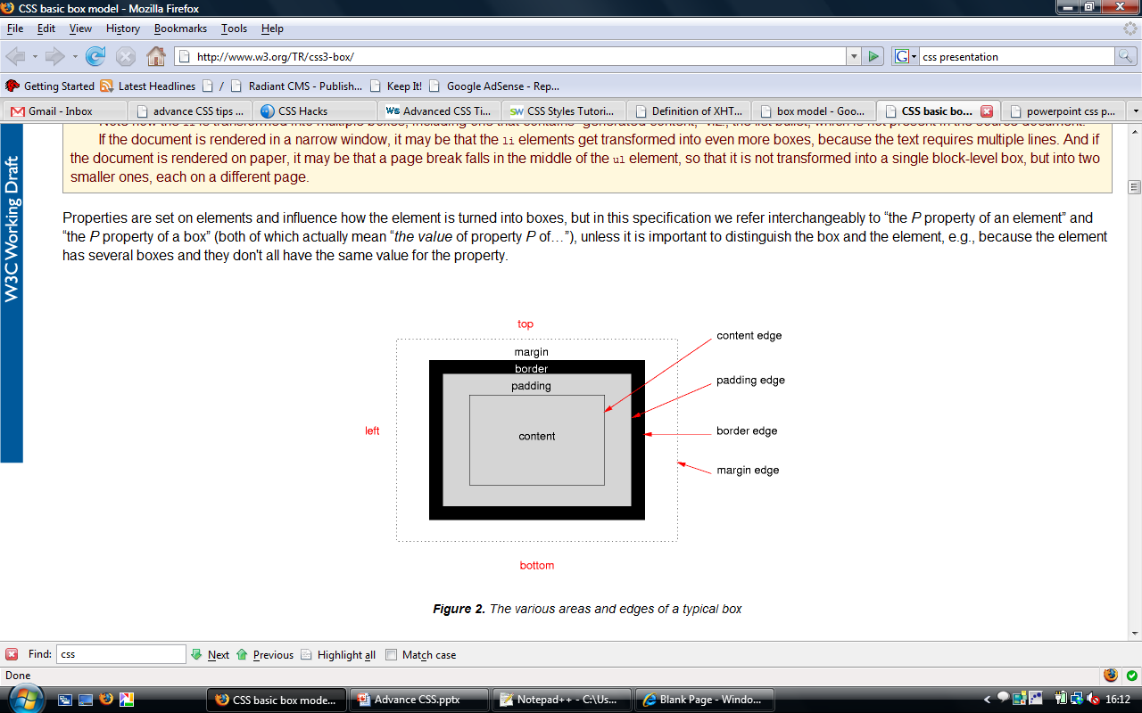
The CSS box model is made up of four parts:
margin
border
padding
content

Slide 5
Continue…
The margin is the outermost edge of the box. It is transparent and manifests as space between the element and others on the page. Margins can collapse into one another, so that the bottom margin of one element overlaps with the top margin of the element below it.
The border is the next thing surrounding the box. Borders can be colored or transparent. If the border is set to 0 it effectively disappears and the border edge is the same as the padding edge.
The padding is the space between the content and the border. Padding is the same color as the background color for the box. If the padding is set to 0, the padding border is the same as the content border.
The content is what most people think of as the element. This is the text or image or whatever is displayed inside the box.

Slide 6
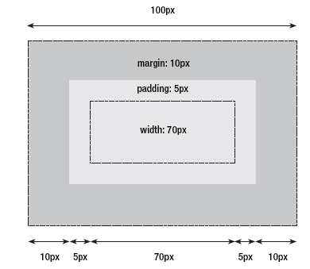
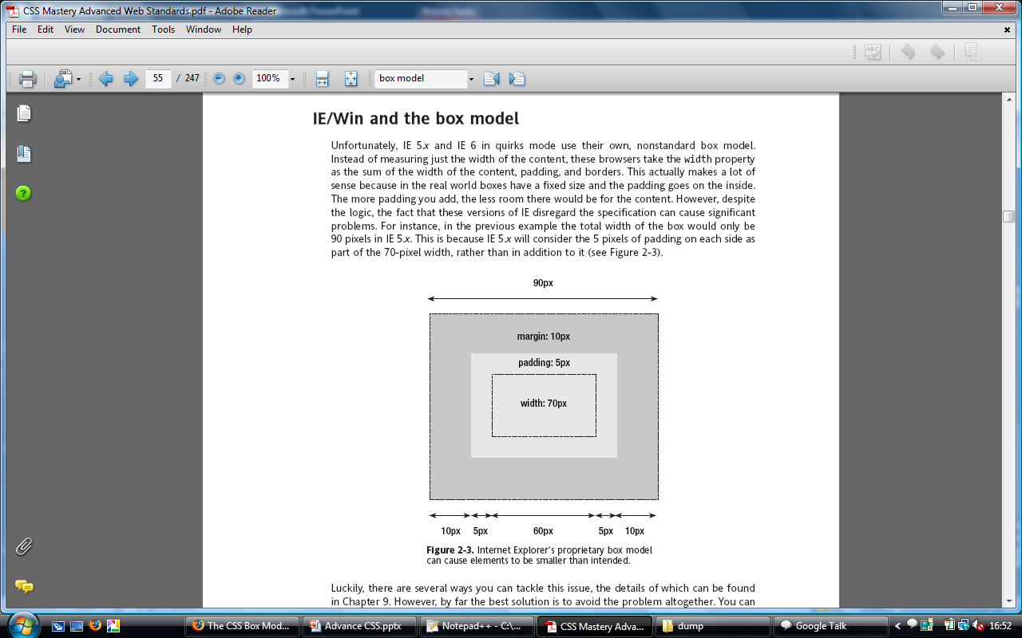
Box Model Issues

Slide 7
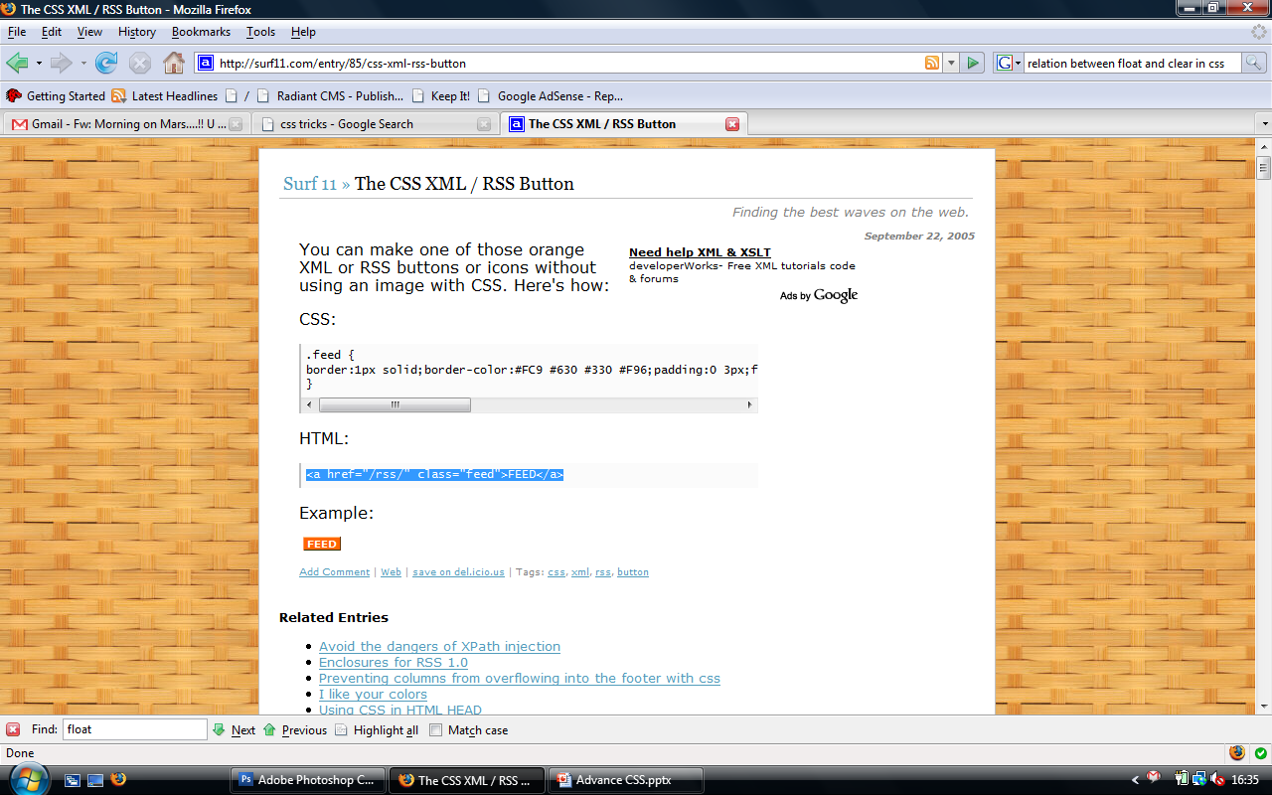
CSS button
You can make one of those orange XML or RSS buttons or icons without using an image with CSS. Here's how:
CSS:
.feed { border:1px solid; border-color:#FC9 #630 #330 #F96;
padding:0 3px; font: bold 10px verdana , sans-serif ;
color:#FFF;background:#F60;text-decoration:none;
margin:4px;
}
HTML:
<a href="/rss/" class="feed">FEED</a>

Slide 8
Working with divs
The <div> tag was designed specifically to take over from tables as a layout tool. It is a block-level DIVsion element that can hold whatever you need inside it. You can have blocks of text in divs and then put them together in a layout. You have immense freedom, with the ability to add these blocks, or layers, on top of each other.
div#navigation {width: 200px; background: gray; padding: 10px; }

Slide 9
Float
Since divisions are block-level (i.e. they default to 100% of the available screen width and add line breaks between each other), they will all just stack up underneath one another unless you position them in some way. The simplest way to do this is to use the CSS float property, the backbone of most CSS layouts. You can float any element left or right, and it will align itself over to the side of whatever element it is contained within.
With these floating elements you can mimic a table structure, and have your page in a traditional layout without all the drawbacks of tables. But CSS wasn't content to merely emulate the layout mechanisms of the past, now you can control the position of elements on the page down to the pixel.

Slide 10
Clear
Image and text elements that appear in another element are called floating elements.
The clear property sets the sides of an element where other floating elements are not allowed.
Values are
  Left
  Right
  none

Slide 11
Tableless designs
DIVs can be an alternate to <table>
DIVs are a container like a table cell
CSS can position the DIV
<div id="article">xxx</div>
#article{
width:250px;
padding:5px;
float:right;}
Example of flexible tableless Design

Slide 12
!important
Normally in CSS whichever rule is specified last takes precedence. However if you use !important after a command then this CSS command will take precedence regardless of what appears after it. This is true for all browsers except IE. An example of this would be:
margin-top: 3.5em !important;
margin-top: 2em
So, the top margin will be set to 3.5em for all browsers except IE, which will have a top margin of 2em. This can sometimes come in useful, especially when using relative margins (such as in this example) as these can display slightly differently between IE and other browsers.

Slide 13
CSS box model hack
The box model hack is used to fix a rendering problem in pre-IE 6 browsers, where by the border and padding are included in the width of an element, as opposed to added on. For example, when specifying the dimensions of a container you might use the following CSS rule:
#box
{
width: 100px;
border: 5px;
padding: 20px;
}
#box
{
width: 150px;
}
#box div
{
border: 5px;
padding: 20px;
}
Regular Code
Code with Hack

Slide 14
Grouping styles
You can give the same properties to a number of selectors without having to repeat them by separating the selectors by commas. It is a useful thing for reducing file size.
Example
h2, .thisOtherClass, .yetAnotherClass
{
color: red;
}
h2
{
color: red;
}
.thisOtherClass
{
color: red;
}
.yetAnotherClass
{ color: red; }
Grouped CSS
h1, h2, h3, h4, h5, h6
{
color: blue;
}
Normal CSS

Slide 15
Nested Styles
If the CSS is structured well, there shouldn't be a need to use many class or ID selectors. This is because you can specify properties to selectors within other selectors.
#top { background-color: #ccc; padding: 1em }
#top h1 { color: #ff0; }
#top p { color: red; font-weight: bold; }

Slide 16
Conditional CSS
a[href $='.pdf'] {
padding-right: 18px;
background: transparent url(icon_pdf.gif) no-repeat center right;
}
This would attach a pdf icon to the right of any hyperlink who's URL ended in '.pdf' like this. This was pretty exciting and heady stuff. It meant I could show the file type visually with that application's icon just by including a few lines in my master css file. I didn't have to worry about it at all in my html, css would add the icon for me automatically.

Slide 17
Cont.
span[id ^='google'] {
background-color: green;
}
Any span which has an id which starts with 'google' will be assigned a green background.

Slide 18
Cont.
a[target=_blank] {
background-color: yellow;
}
The link with target="_blank" gets a yellow background

Slide 19
Cont.
[title~=flower] {
border: 5px solid yellow;
}
Select and style elements with a title attribute containing the word "flower“
https://www.w3schools.com/cssref/css_selectors.asp

Slide 20
Responsive & Adaptive Design
Responsive design (RWD) - was firstly put forward by Ethan Marcotte and applied when designing a webpage and changing the size of page in order to adapt to different resolutions screen via the CSS Media Query, Content (Based Breakpoint) and other technologies.Any span which has an id which starts with 'google' will be assigned a green background.
Adaptive design (AWD) - is about creating different pages in accordance with the specific size of a device. It will showcase corresponding page according to the screen resolution of the device. This will display different pages based on different screen resolution.

Slide 21
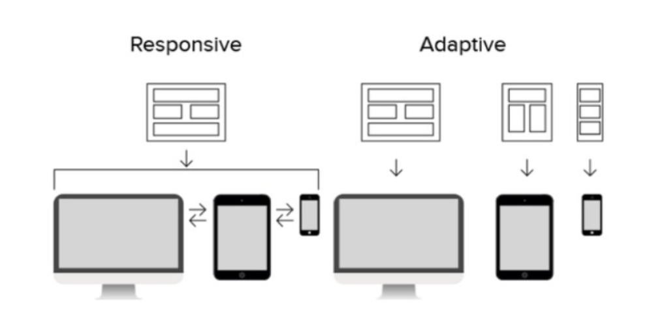
Responsive & Adaptive Design

Slide 22
CSS Media Queries
CSS Media Queries are a feature in CSS3 which allows
you to specify when certain CSS rules should be applied.
This allows you to apply a special CSS for mobile, or
adjust a layout for print.

Slide 23
Coding Media Queries
The following code will display the font-size at 100% if the width is at least 1024 px
@media screen and (min-width: 1024px) {
body {font-size: 100%;}
}
The following code tests the orientation and the device-width
@media screen and (min-device-width: 480px) and (orientation: landscape) {
body { font-size: 100%; }
}
@media (min-width: 600px) and (max-width: 800px) {
.testClass
{ background: red; }
}
The logical operators are pretty interchangeable:
  The operator “and” can be replaced with “not”. The orientation “portrait” with “landscape”.

